Slide 1
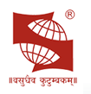
SYMBIOSIS INTERNATIONAL (DEEMED UNIVERSITY)
IOT BASED ALCOHOL MONITORING SYSTEM
Presented by: Group 4
Name of the students | PRN
RUDANSH MALHOTRA | 19070123095
SAMIKSHA SHUKLA | 19070123099
TUSHAR YADAV | 19070123126
VARUN SARATHY | 19070123131
Under the guidance of
Prof. Harikrishnan R Department of E&TC, SIT Pune

Slide 2
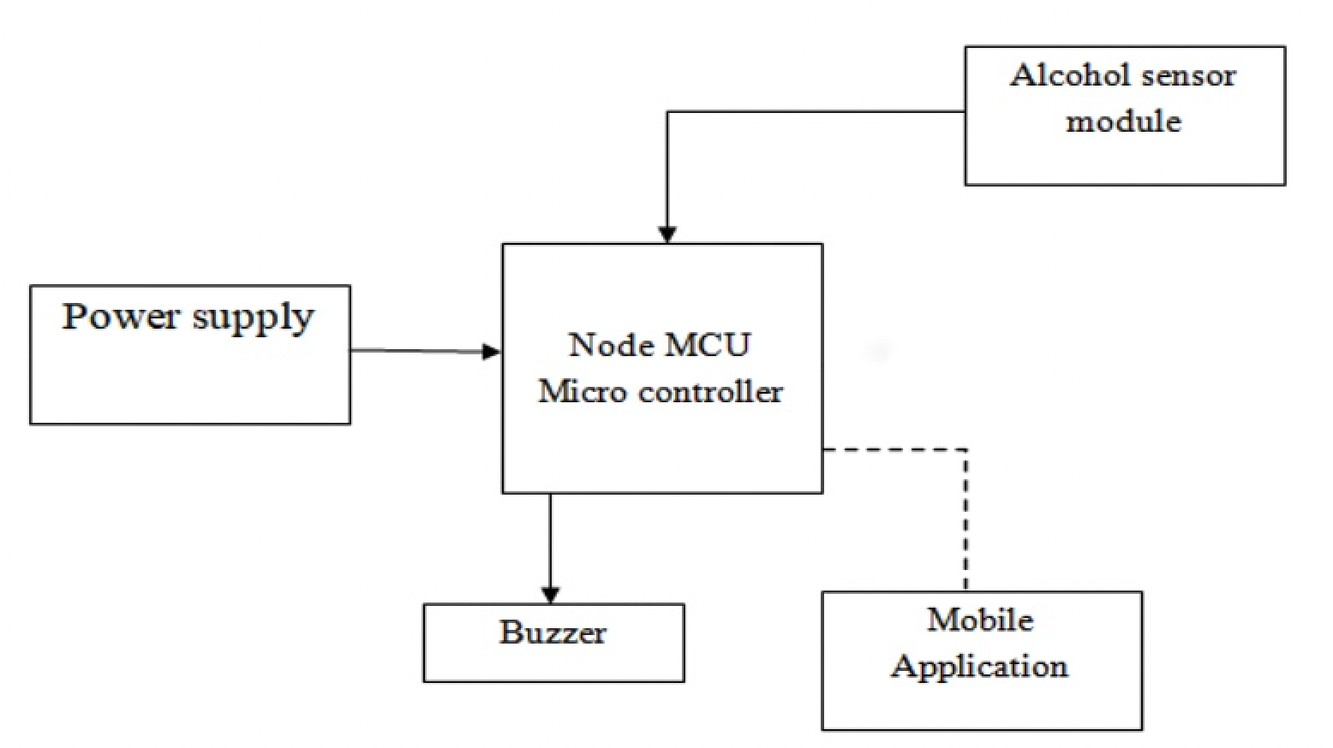
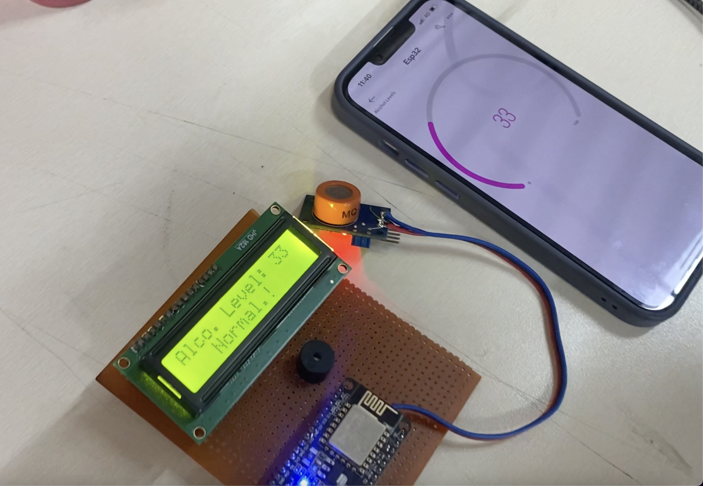
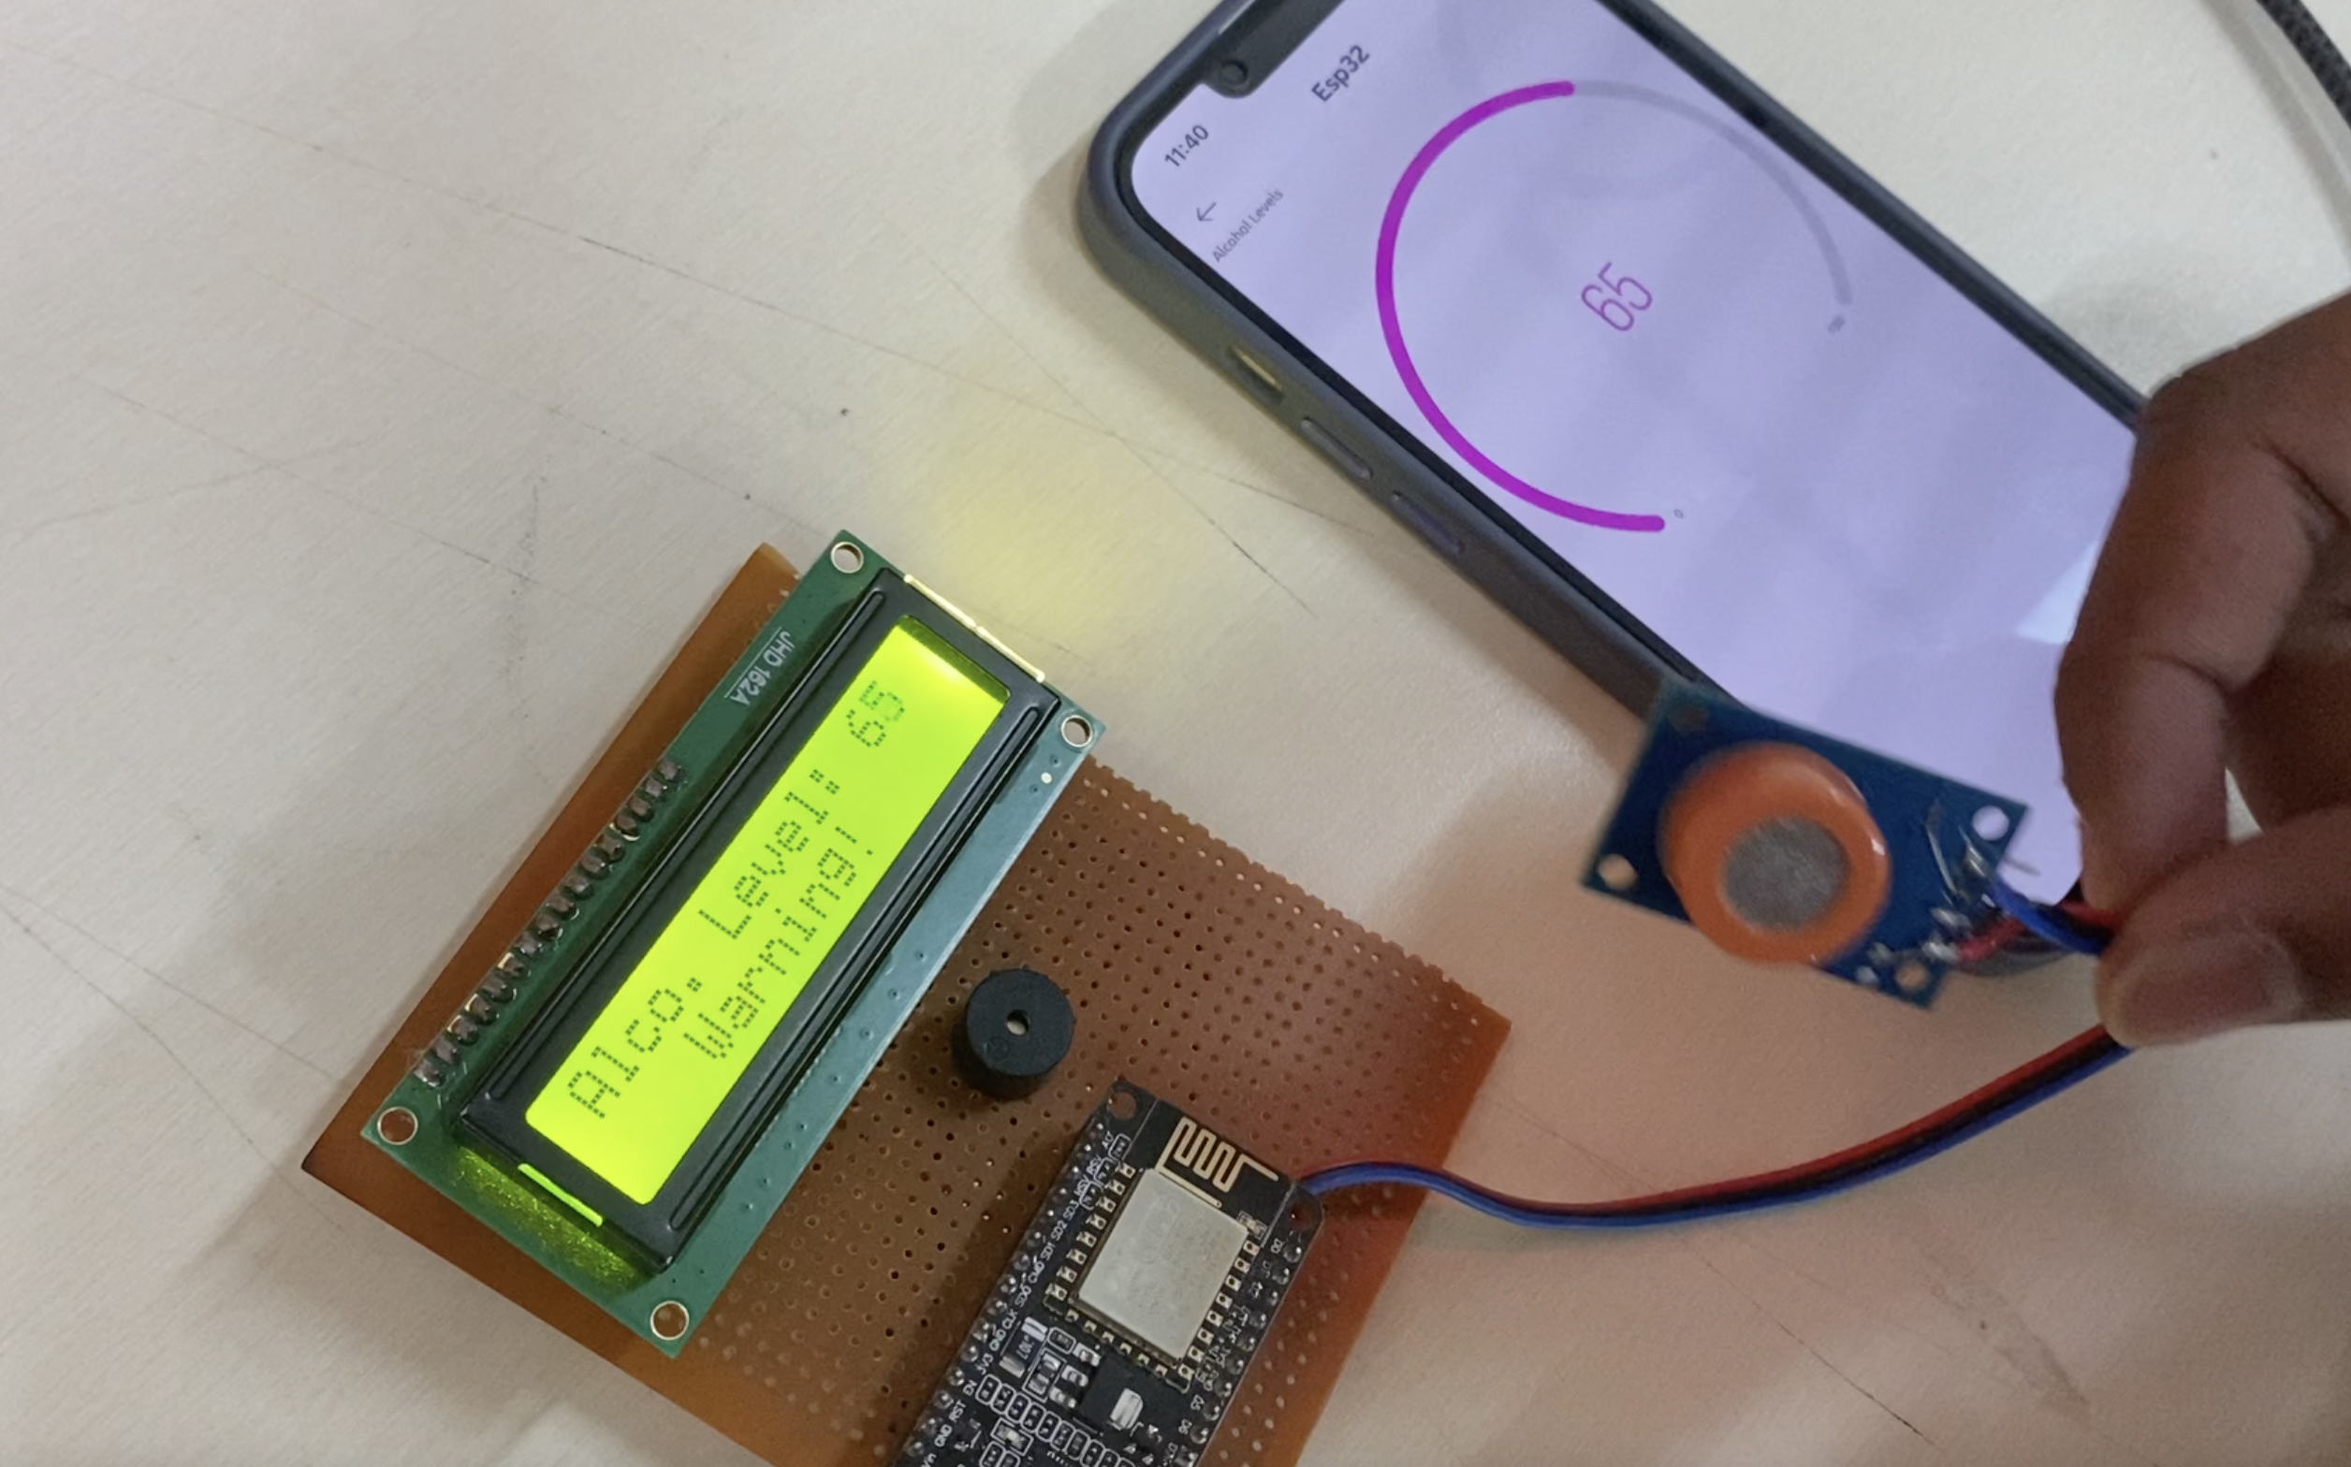
Introduction - The project is on IOT based Alcohol Detection system for Transport buses/car. Transports are used on Larger scale for daily Transport to distinct place, so secure and Healthy Environment should be repeatedly we may observe people taking alcohol in Prohibited place. Transport driving is one among that places alcohol is strictly Prohibited. are often installed at anywhere monitoring in driving person.
Alcohol Sensor - In this alcohol sensor detect the alcohol person. It is a low-cost semiconductor device it have four pins first pin is AO, second pin is DO , third pin is VCC , fourth pin is ground. It is a sensitive material .A simple interface is could be a 0-3.3V ADC .
Why MQ3 sensor for Alcohol detection
1)The sensitivity of Alcohol, Ethanol is good
2)Easy to use and fix
3)Adjustable value
4)Low price
5)Can be used in various alcohol detection projects
NODE MCU ESP8266 - The ESP32 is a low-cost system-on-chip (SoC) series created by Systems. It is an improvement on the popular ESP8266 that is widely used in IoT projects. The ESP32 has both Wi-Fi and Bluetooth capabilities, which make it an all-rounded chip for the development of IoT projects and embedded systems in general. In this tutorial, you will learn how to get started with the ESP32 and learn how to use it to connect to a Wi-Fi hotspot.
BUZZER - A buzzer could be a tiny however economical part to feature sound options to our project/system. it's terribly tiny and compact 2- pin structure thus may be simply used on bread board, Perf Board and even on PCBs that makes this a wide used part in most electronic applications.
BLNK APPLICATION - Blynk is a Platform with IOS and Android apps to control Arduino, Raspberry Pi and the likes over the Internet. It’s a digital dashboard where you can build a graphic interface for your project by simply dragging and dropping widgets.
Conclusion - Alcohol detection system is mainly integrated and developed for road transportation Safety for the people Who are living in the smart cities can enjoy the availability of Alcohol detection system. This mainly works with the help of IoT.

Slide 3
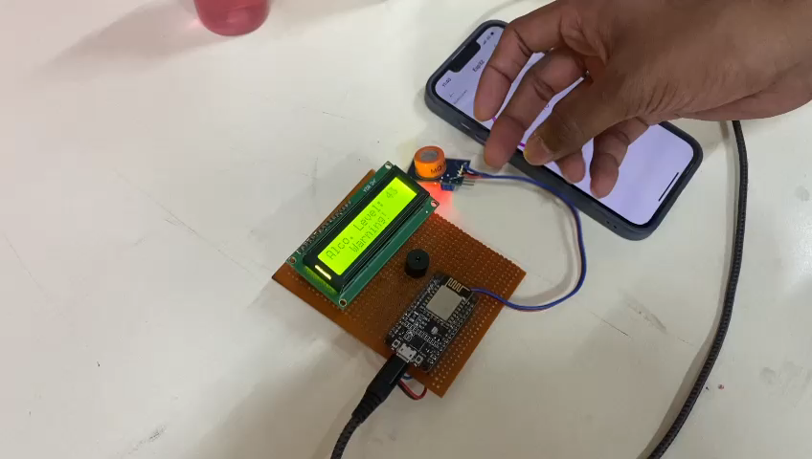
Project Demo Video:

